Slide 1
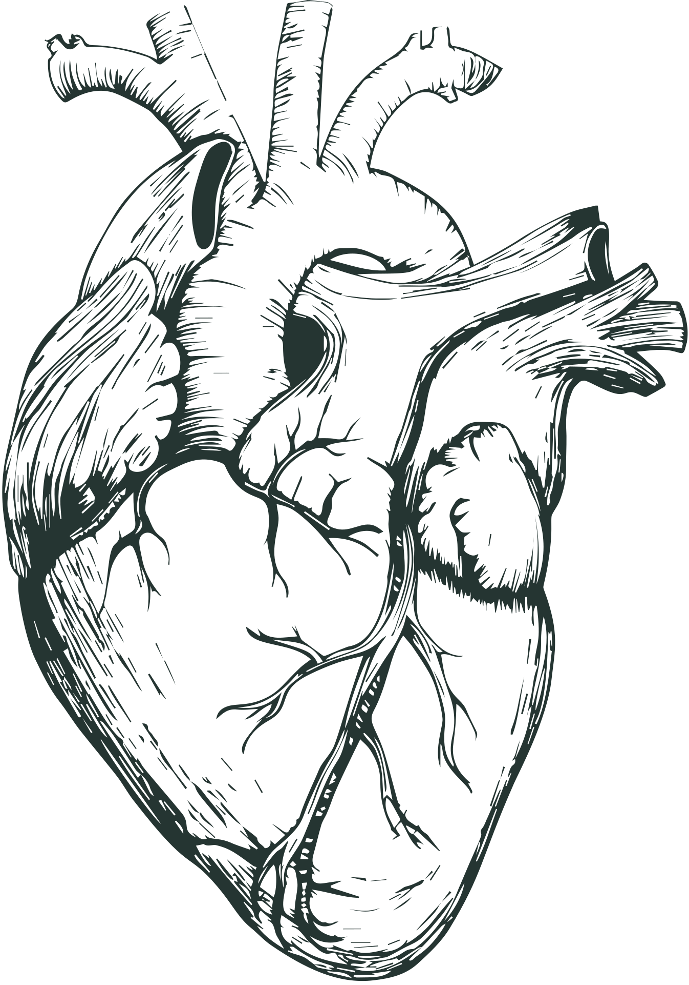
CARDIOVASCULAR DISEASE
CLASSIFICATION
Mock Presentation
Group 4:
Aditya Nayak
Charith Govardhanam

Slide 2
INTRODUCTION

Slide 3

Problem Statement: Identifying individuals at risk of Cardiovascular Disease (CVD) remains challenging due to limitations in current risk prediction models, which often rely on a narrow set of predictors and fail to accurately assess lifetime risk.
Problem Elaboration: Traditional CVD risk models may underestimate risk for low-risk individuals. ML methods offer promise by identifying novel risk factors and improving long-term risk assessments. However, research on ML's role in CVD prediction is currently limited.

Slide 4
Project Scope: Developing a classification Machine Learning (ML) model for Cardiovascular Disease (CVD) risk prediction, aiming to improve accuracy by identifying novel risk factors and understanding their complex relationships.
Motivation
Enhancing Precision in Risk Assessment: Identifying CVD risk crucial for timely prevention and better outcomes.
Addressing Limitations of Current Approaches: Traditional CVD risk models overlook factors, needing more sophisticated methodologies.

Slide 5
LITERATURE REVIEW

Slide 6

Study of cardiovascular disease prediction model based on random forest in eastern China
The study tailored a CVD prediction model for eastern China, identifying 30 risk indicators. Random Forest outperformed benchmarks with an AUC of 0.787. These findings highlight ML's potential for personalized risk assessment and targeted interventions in CVD prevention in China.
Cardiovascular disease risk prediction using automated machine learning
AutoPrognosis, an ML technique, significantly outperformed traditional methods in CVD risk prediction, achieving an AUC-ROC of 0.774. By incorporating novel variables like walking pace, it improves risk assessment, particularly for underserved patient subgroups like those with diabetes, indicating promising avenues for enhanced prediction.
Lifetime Risks of Cardiovascular Disease
The study explored lifetime CVD risks across age groups and races, finding healthier habits significantly reduce heart disease risk compared to risk factors like high blood pressure or smoking, consistent across demographics. Early prevention of such factors is vital for long-term heart health improvements.

Slide 7
METHODOLOGY

Slide 8
Data Description
17 Attributes
Eating Habits
Physical Condition
Other Attributes
Target Variable: NObeyesdad (Obesity level deducted)
Files
ObesityDataSet.csv (2111 records)
train_dlm.csv (20,758 records)
test.csv (13,840 records)
Data Collection
Conducted through a web platform survey.
Participants were anonymous users who responded to a series of questions.
Survey included questions related to eating habits, physical condition, and demographics.
Responses were collected and processed to generate the dataset.

Slide 9

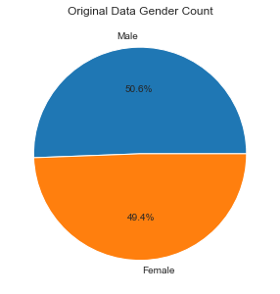
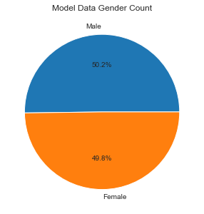
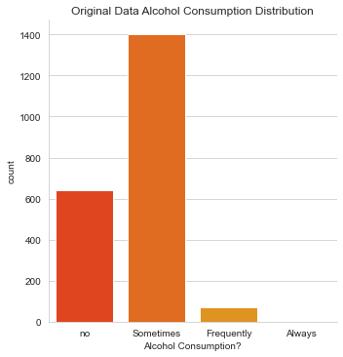
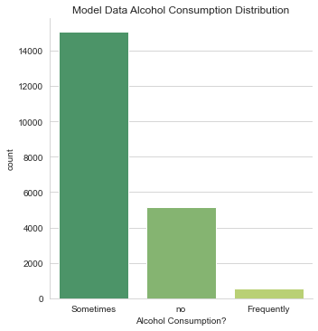
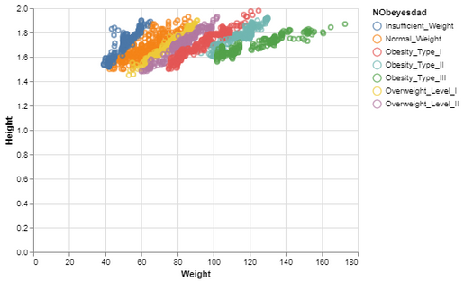
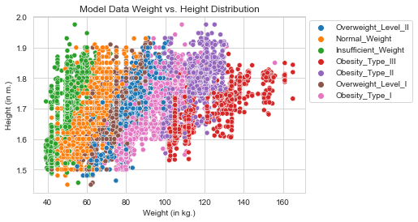
Exploratory Data Analysis

Slide 10
Data Modeling
Random Forest
XGBoost
Multilayer Perceptron
TensorFlow
Logistic Regression
K-Nearest Neigbour
Gradient Boosting
Naive Bayes
Why these models??
Random Forest: Ensemble method combining multiple decision trees for robust and accurate predictions.
XGBoost: Optimized gradient boosting implementation offering speed, performance, and regularization for structured data.
Multilayer Perceptron (MLP): Neural network with multiple layers capable of learning complex patterns in data.
Gradient Boosting: Sequential ensemble learning technique correcting errors of previous models for high accuracy.

Slide 11
RESULTS & ANALYSIS

Slide 12

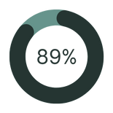

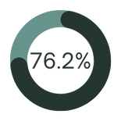
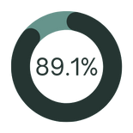

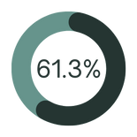
Results for the Originial Dataset
Why this model?
Multilayer Perceptron is chosen for its capability to learn complex patterns in data, making it suitable for tasks requiring nonlinear relationships between features and target variables.
Its multiple layers of interconnected nodes allow for hierarchical feature representation, enabling it to capture intricate relationships.
Additionally, MLPs are highly adaptable to various types of data and can be effectively trained using techniques like backpropagation.
Accuracy
Random Forest
XGBoost
Multilayer Perceptron
Logistic Regression
K-Nearest Neighbour
Gradient Boosting
Naive Bayes

Slide 13



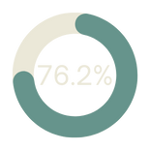

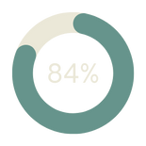

Results for the Deep Learning Model Dataset
Why this model?
The XGBoost model is a top choice due to its optimized implementation of gradient boosting, offering superior speed, performance, and regularization for structured data.
It excels in handling missing values and can automatically handle feature interactions.
Its ensemble learning approach sequentially corrects errors of previous models, resulting in high predictive accuracy.
Accuracy
Random Forest
XGBoost
Multilayer Perceptron
Logistic Regression
K-Nearest Neighbour
Gradient Boosting
Naive Bayes

Slide 14
CONCLUSION

Slide 15
Conclusion
Through extensive exploratory data analysis (EDA) and model experimentation, we have evaluated various machine learning algorithms, prioritizing accuracy as our primary metric.
Our findings indicate that for the original dataset, the Multilayer Perceptron (MLP) model emerges as the best choice, demonstrating superior performance in capturing complex patterns and achieving high accuracy.
Whereas for the deep learning model dataset, XGBoost stands out as the preferred model, utilizing its optimized implementation of gradient boosting to excel in predictive accuracy and scalability.
Overall, our comprehensive approach, thorough EDA and model evaluation of different models highlight how the importance of selecting appropriate algorithms that match the data characteristics and task requirements which leads to strong and reliable predictions.

Slide 16
REFERENCES

Slide 17
References
World Heart Federation. (2023, August 10). Cardiovascular Disease (CVD) | World Heart Federation.
https://world-heart-federation.org/what-is-cvd/
Yang, L., Wu, H., Jin, X., Zheng, P., Hu, S., Xu, X., Yu, W., & Yan, J. (2020). Study of cardiovascular
disease prediction model based on random forest in eastern China. Scientific Reports, 10(1).
https://doi.org/10.1038/s41598-020-62133-5
Alaa, A. M., Bolton, T., Di Angelantonio, E., Rudd, J. H., & Van Der Schaar, M. (2019). Cardiovascular
disease risk prediction using automated machine learning: A prospective study of 423,604 UK Biobank
participants. PLOS ONE, 14(5), e0213653. https://doi.org/10.1371/journal.pone.0213653
Jarett D. Berry, M.D., Alan Dyer, Ph.D., Xuan Cai, M.S., Daniel B. Garside, B.S., Hongyan Ning, M.D.,
Avis Thomas, M.S., Philip Greenland, M.D., Linda Van Horn, R.D., Ph.D., Russell P. Tracy, Ph.D., and
Donald M. Lloyd-Jones, M.D. Lifetime Risks of Cardiovascular Disease.
https://www.nejm.org/doi/full/10.1056/NEJMoa1012848

Slide 18


